Slide 1

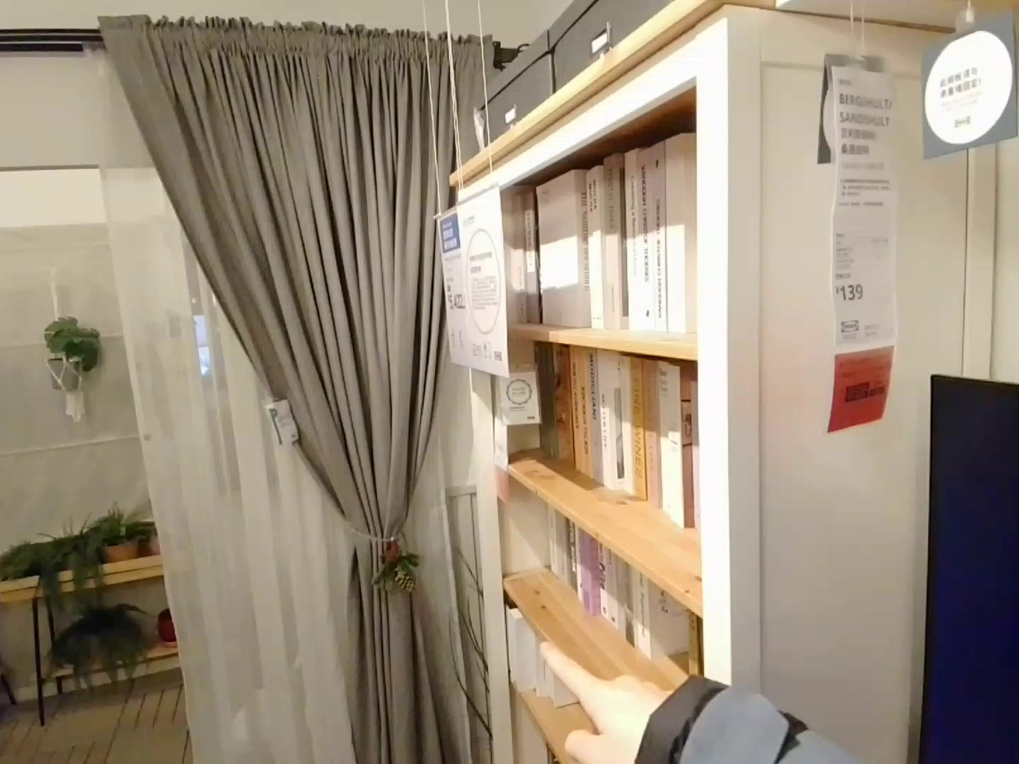



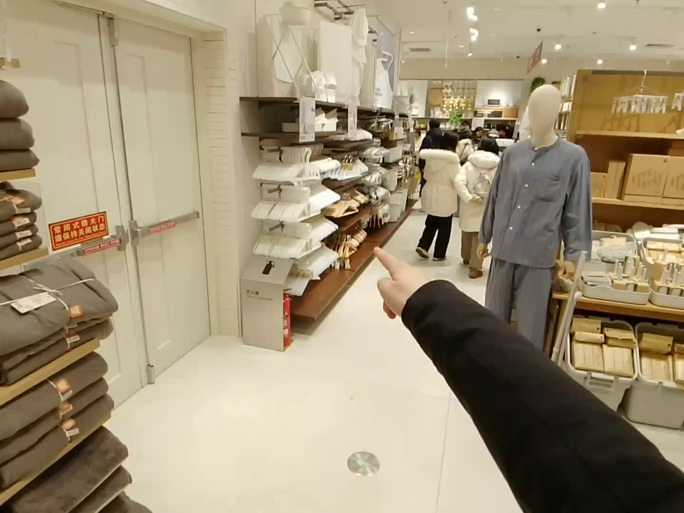
Scene 1: User is pointing at Curtains
What is the use of the object I am pointing to? A. To show the price. B. To make people relax. C. To block the light. D. To place books.
Ground Truth
C. To block the light.
[...] D. To place books.
Reasoning: Your finger is pointing to a shelf within a bookcase [...]
D. To place books.
Scene 2: User is pointing at Clothes hangers
What is the primary purpose of this object? Please output the answer directly.
Ground Truth
To hang clothes.
[...] I’m focusing on the white rectangular object [...] the object being pointed at is a fire extinguisher box.
The primary purpose of this object is to provide a safe exit route [...]

Slide 2
Scene 1: User is pointing at Curtains
What is the use of the object I am pointing to? A. To show the price. B. To make people relax. C. To block the light. D. To place books.
(Ground Truth)
[...] D. To place books.
Reasoning: Your finger is pointing to a shelf within a bookcase [...]
D. To place books.
Scene 2: User is pointing at Clothes hangers
What is the primary purpose of this object? Please output the answer directly.
(Ground Truth)
To hang clothes.
[...] I’m focusing on the white rectangular object [...] the object being pointed at is a fire extinguisher box
The primary purpose of this object is to provide a safe exit route [...]
GT Pointing Area
Confused Area
Pointing Ray

Slide 3
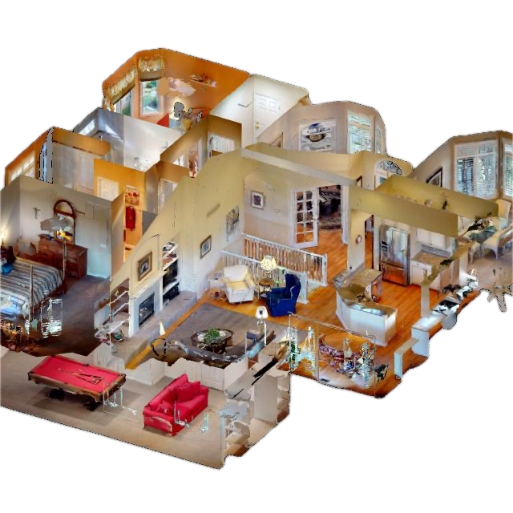
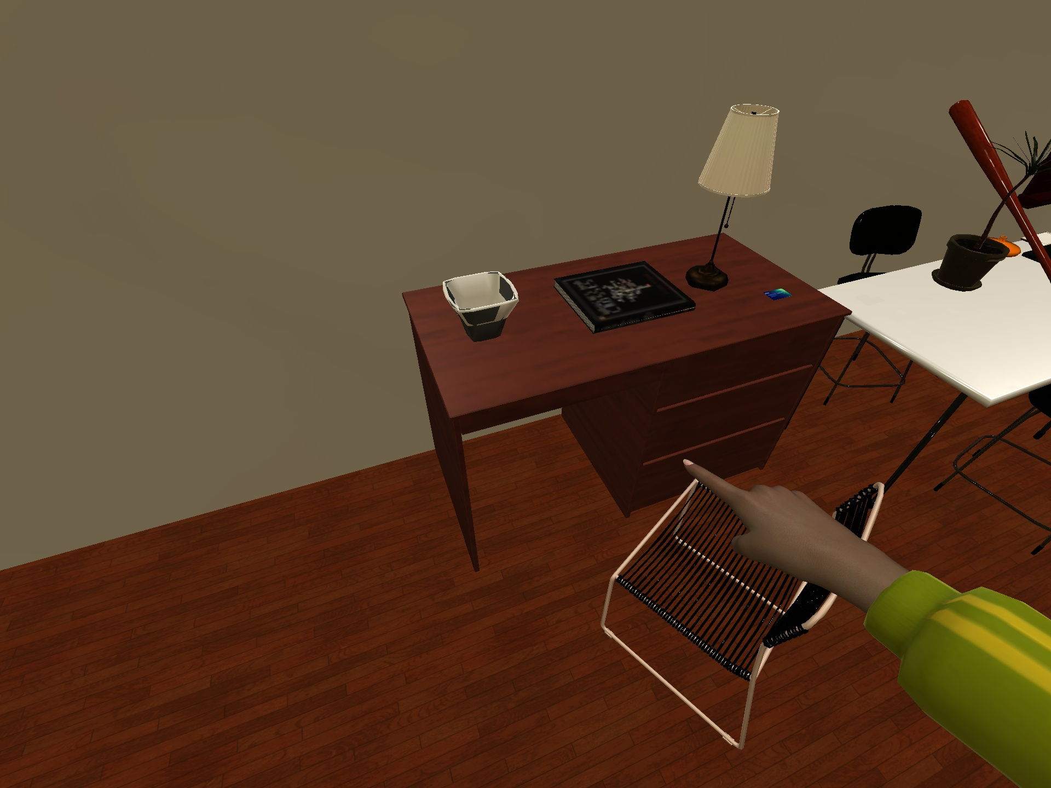
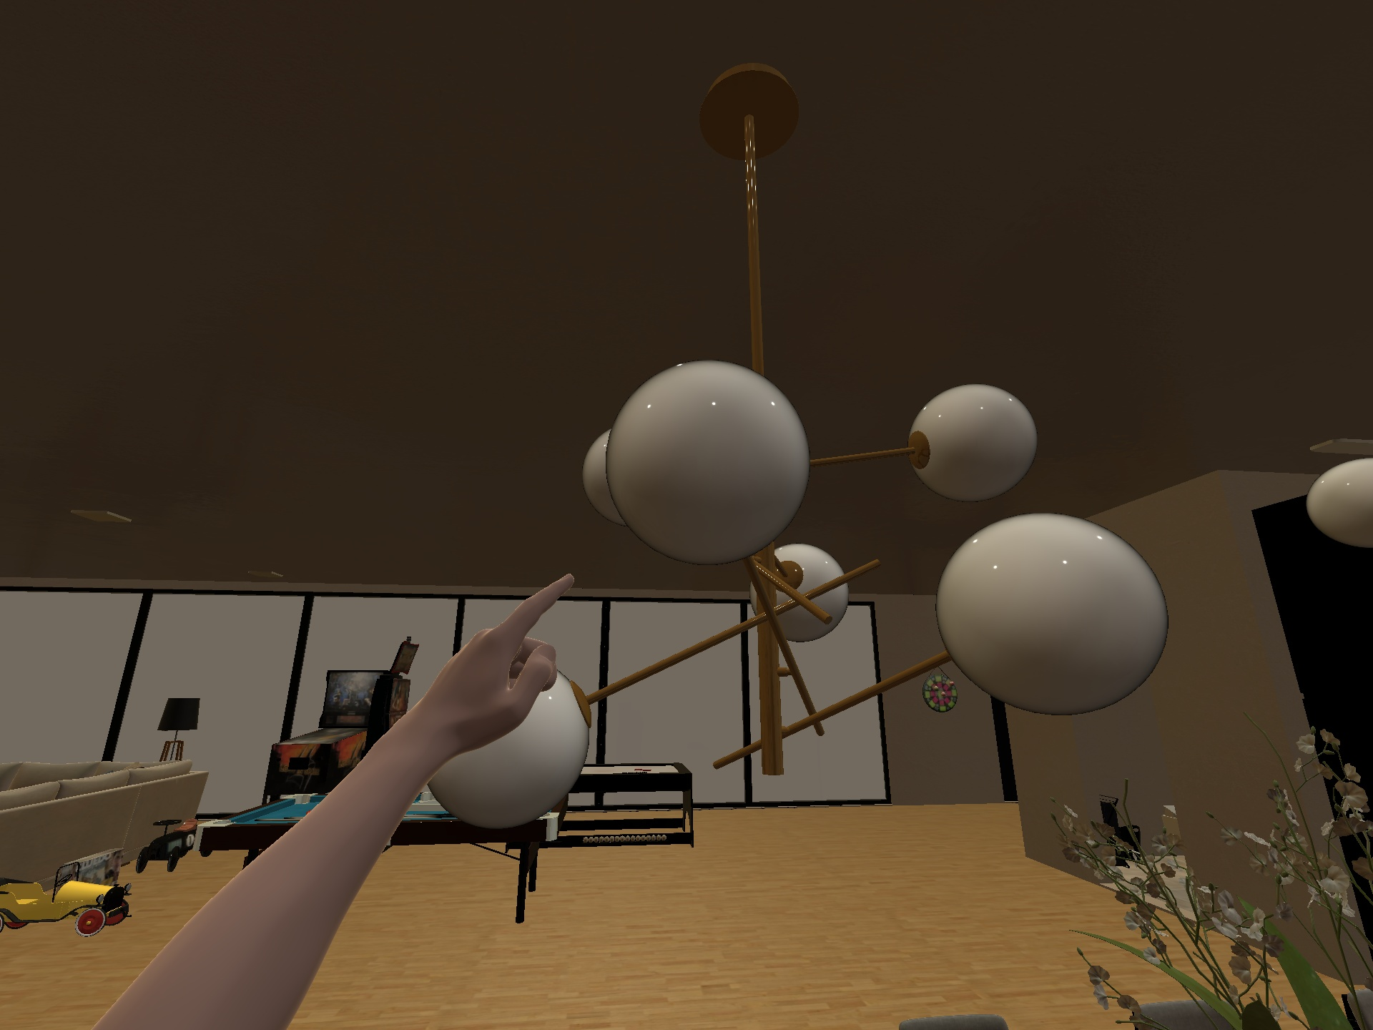





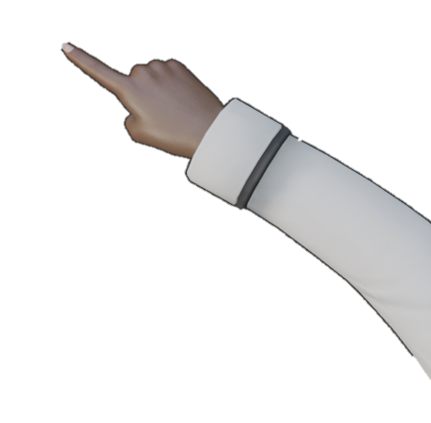


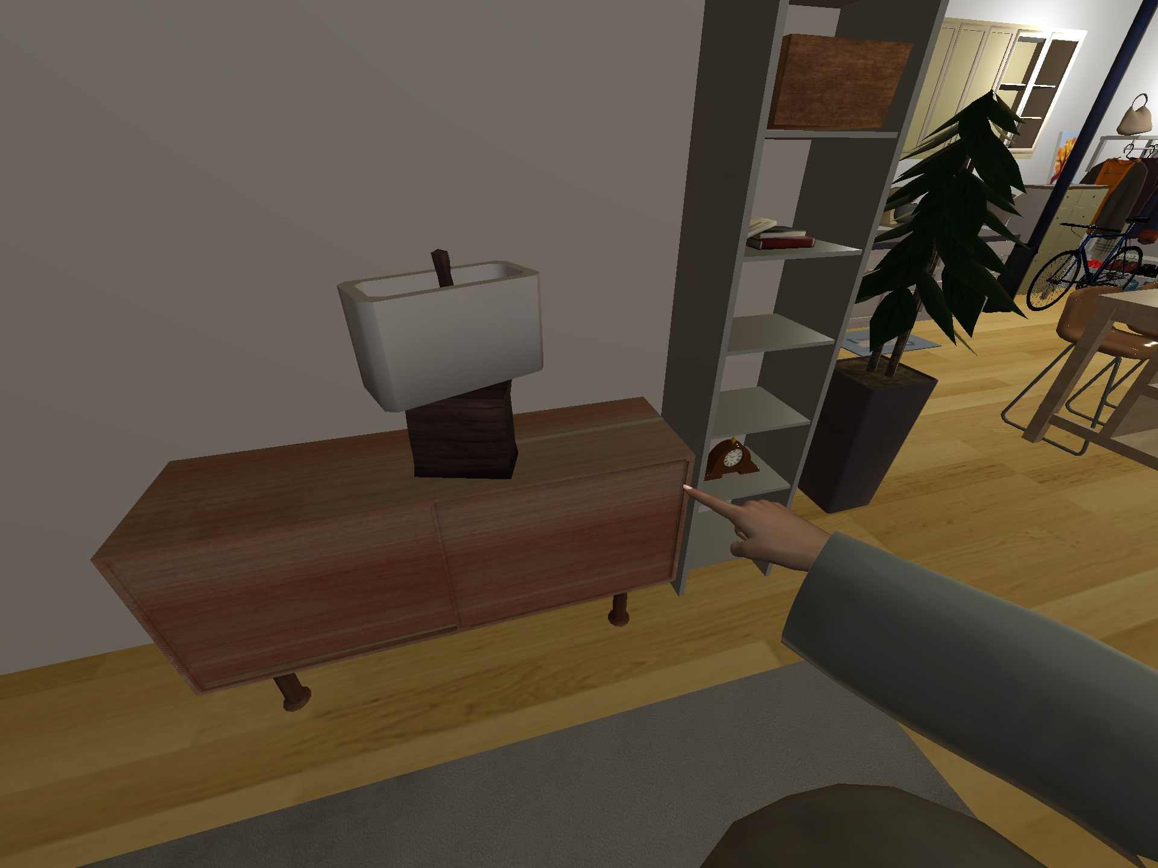
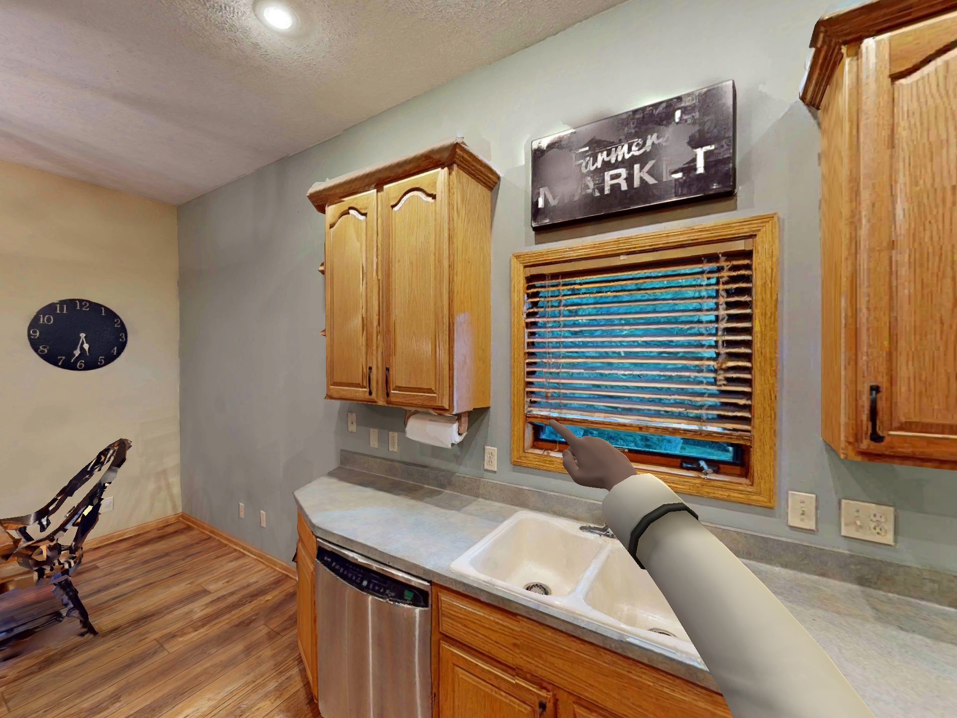
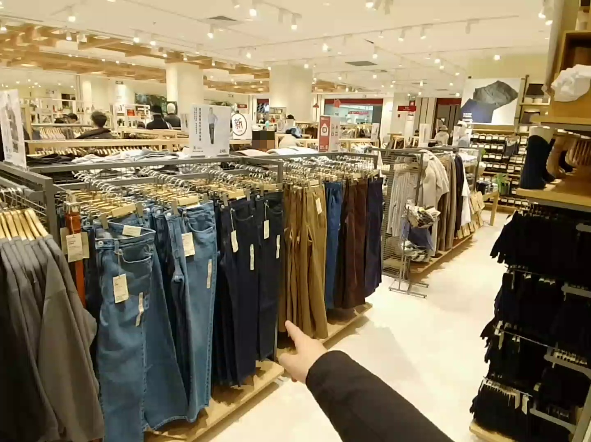
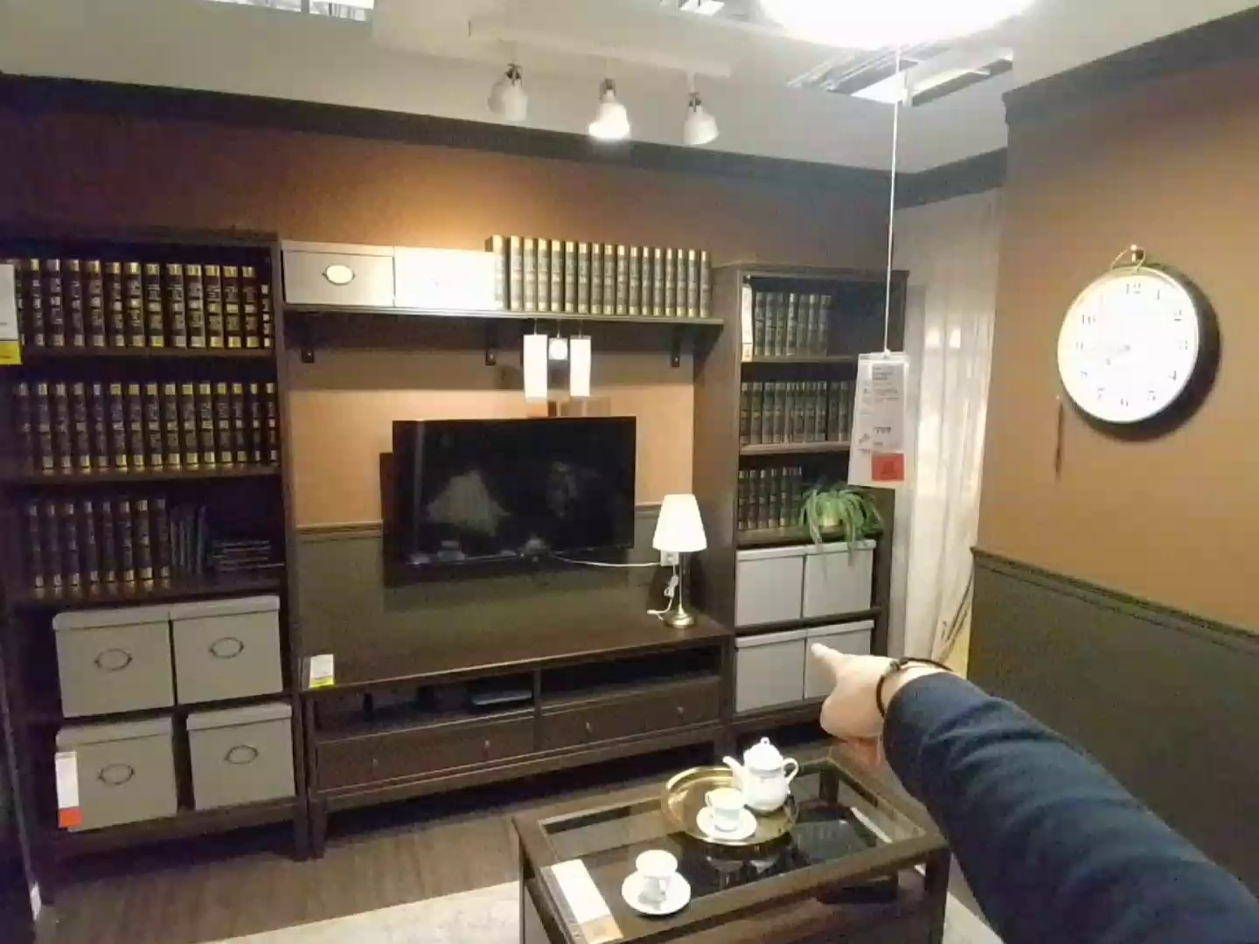
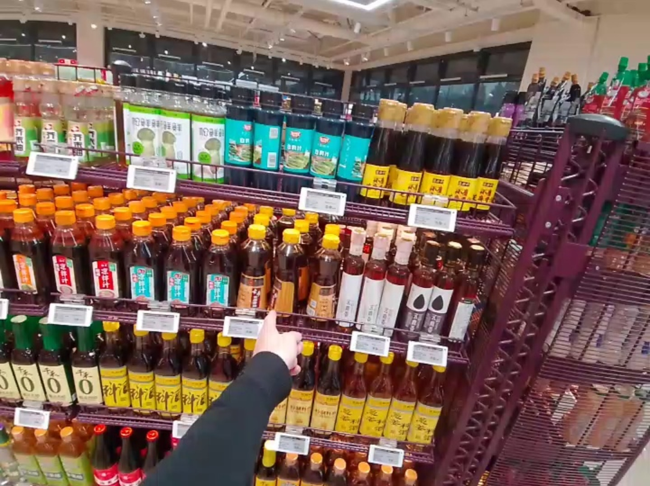

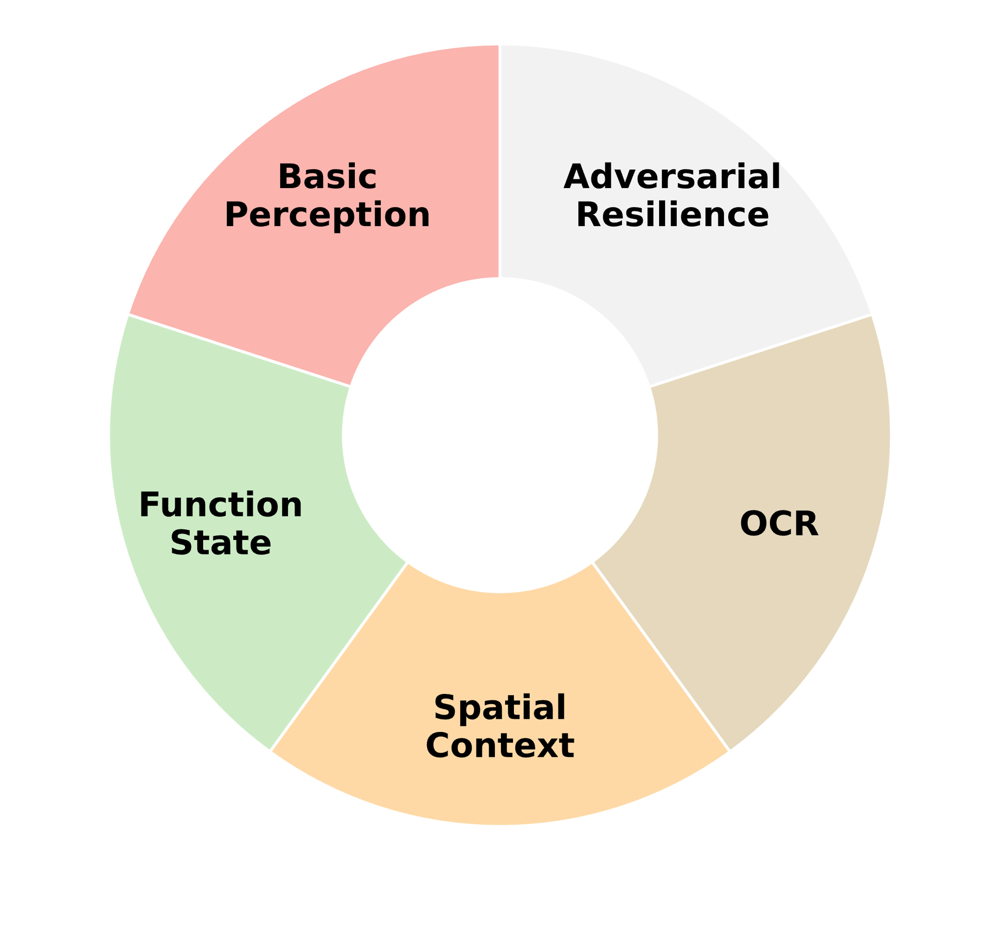







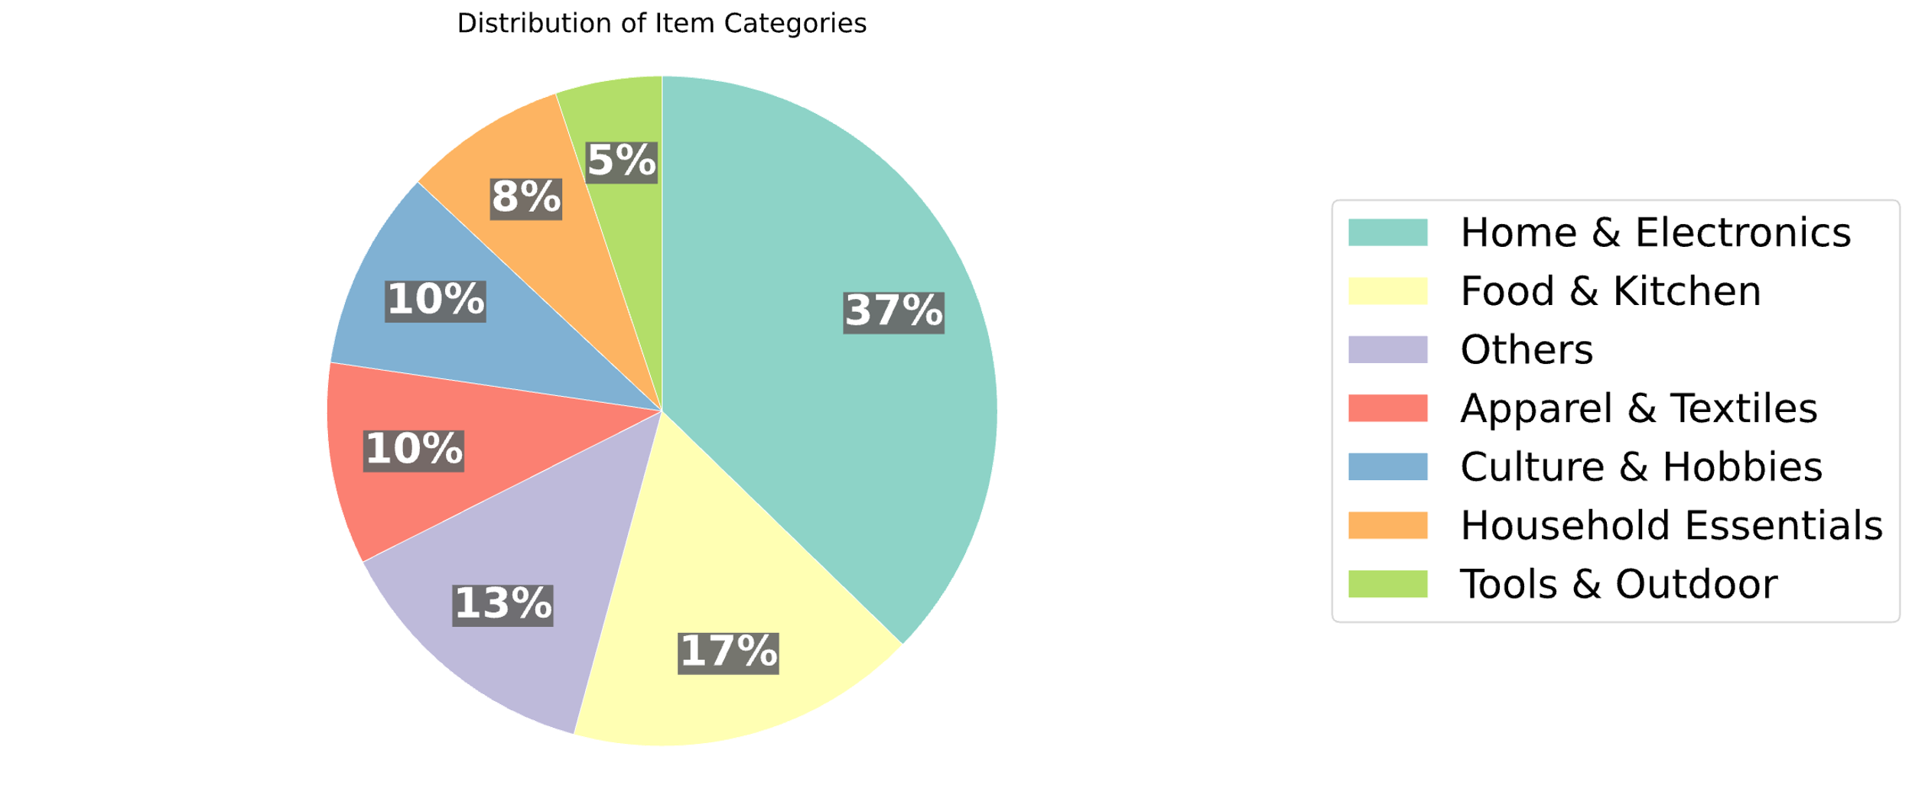
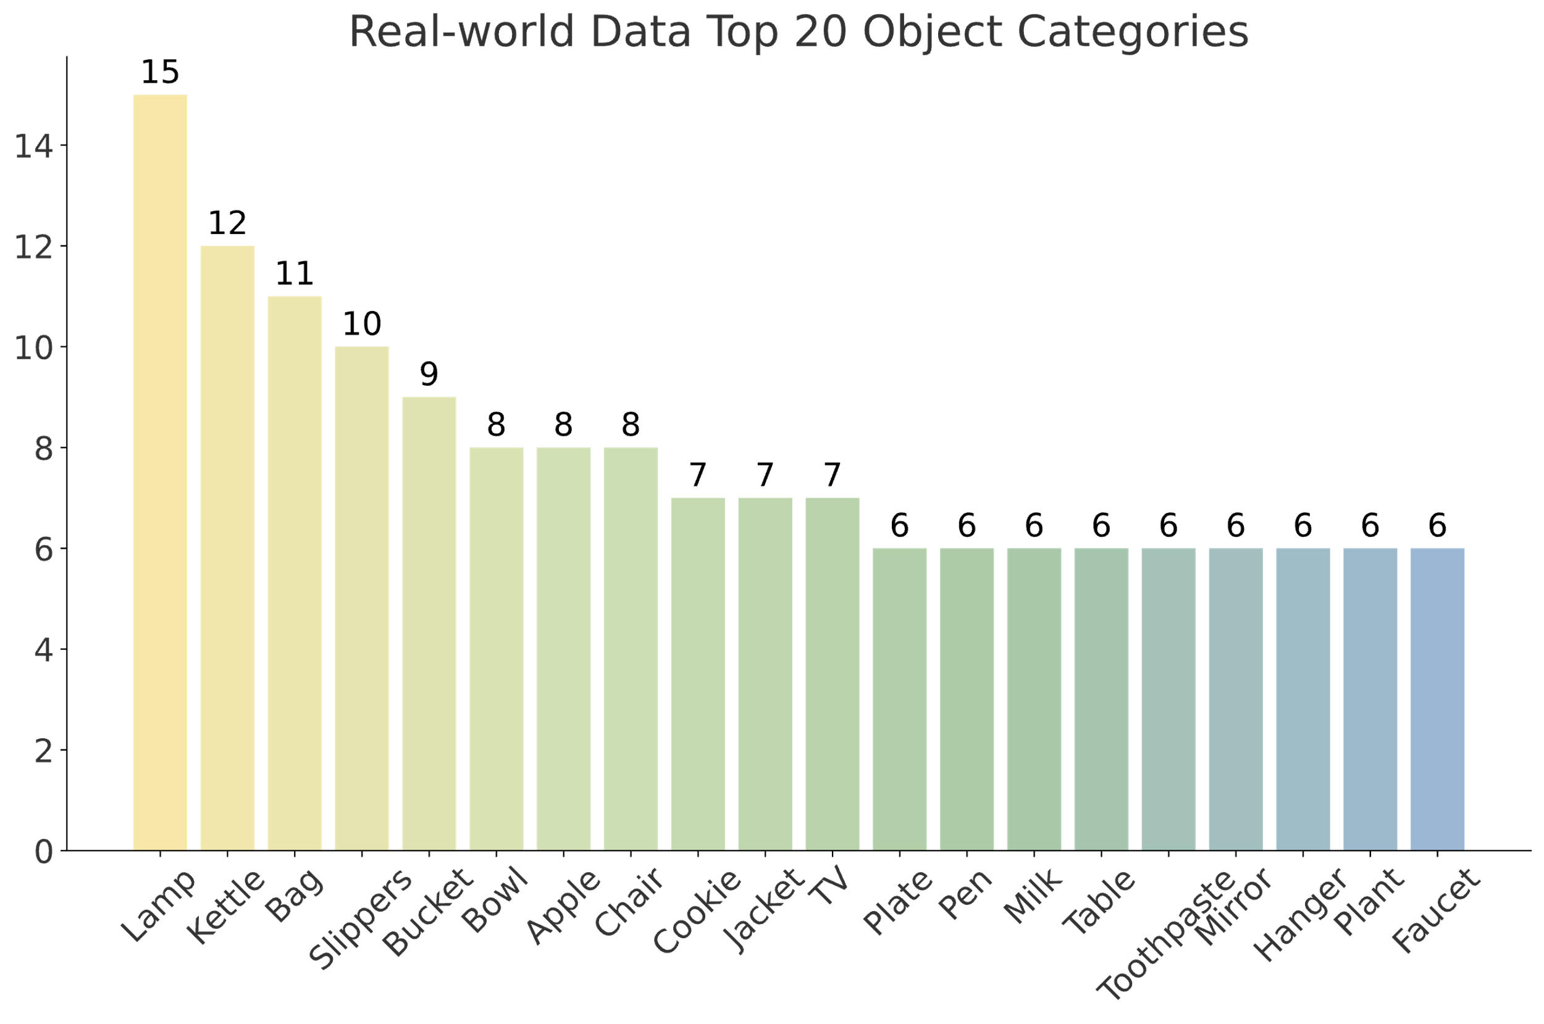
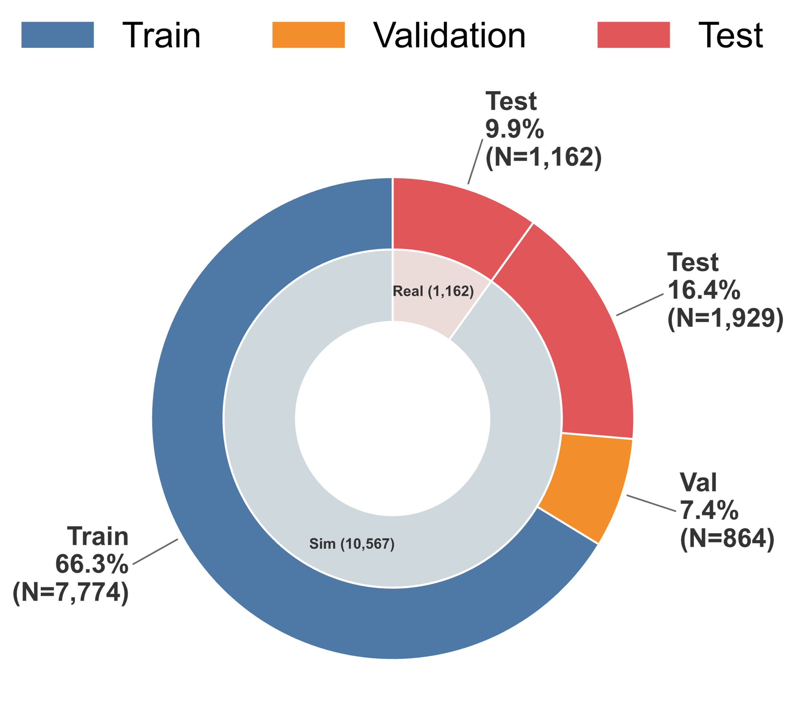
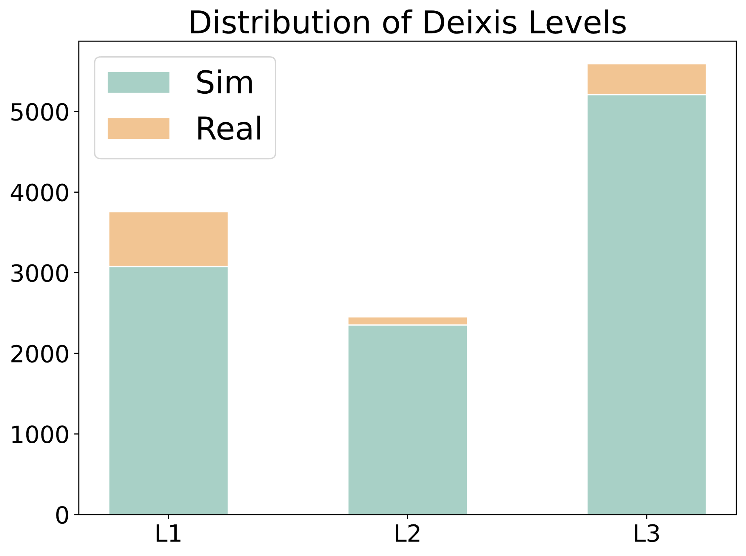
Simulation
Real-world
AI2THOR
HSSD
Point-Sim
Framework
txt
Image Collection
+
...
img
Various places
ReplicaCAD
HM3D
1,838 3D Scenes
910 Object Categories
42 Hand Meshes
Mixed-format QA pairs
Deixis Level
Dimension
① True/False QA
Implicit Pronoun
L3
“this/that”, “it”, “this one”
Yes
No
Towards Abstraction
QA Construction
Check/Annotate
② Single Choice QA
Visual
Locative
“this object right here/over there”
EgoPoint
Bench
L2
A.
B.
C.
D.
③ Open-ended QA
Explicit
Action
L1
“the object I am pointing at”
Generate
GT: To clean hands.
Statistics
(a) Distribution of obj attributes in synthetic data.
(b) Frequency of top-20 object categories in real-world data.
(c) Distribution of Deixis Levels.
(d) Train/Val/Test splits of EgoPoint-Bench.

Slide 4
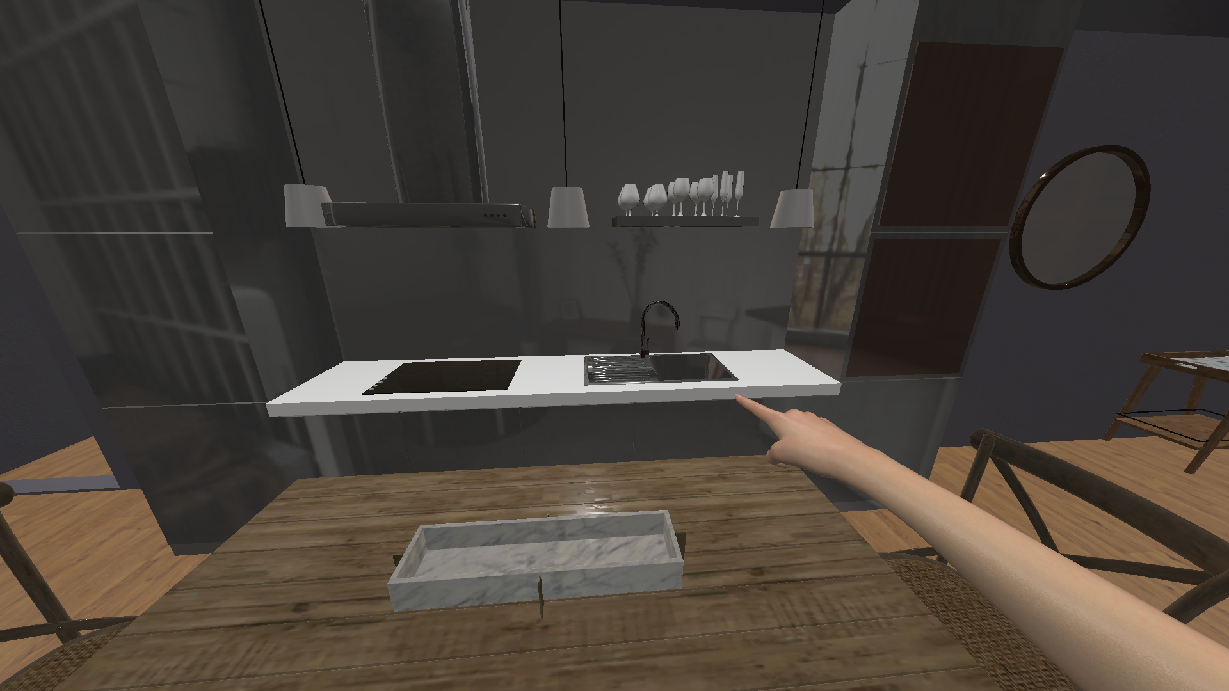
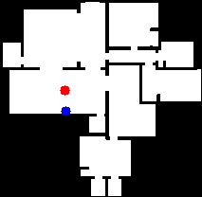

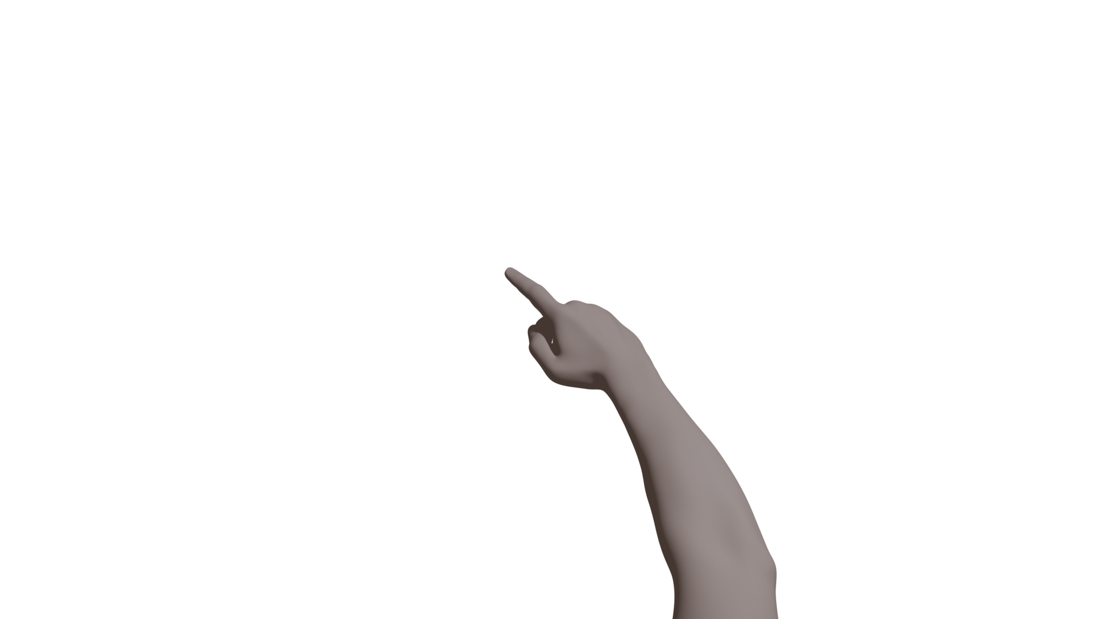
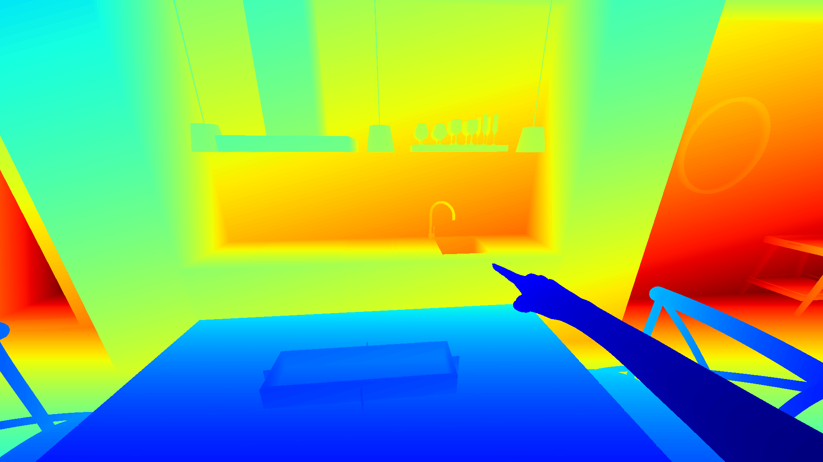

Target
Agent
Missing
Target
RGB
X
Depth
X
Agent
Finger rays did not hit other objs.
Scene Setup
Alignment
Validation

Slide 5
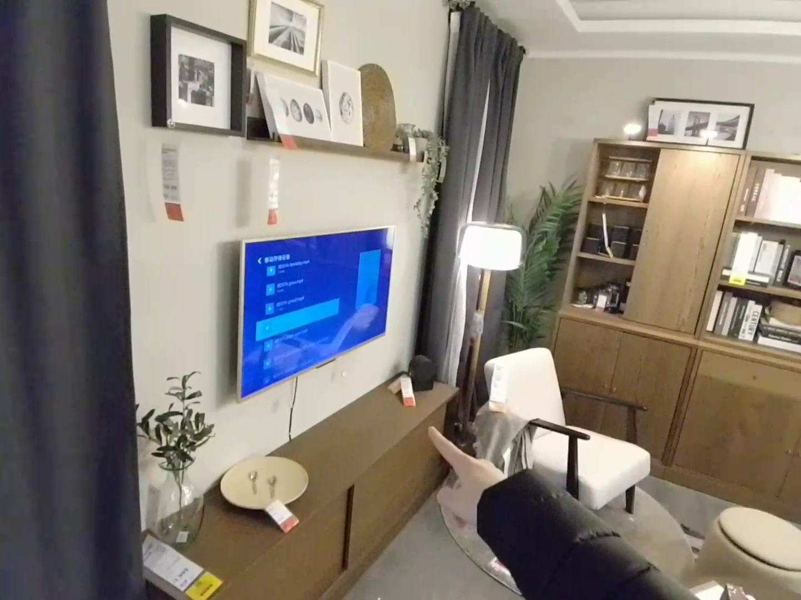
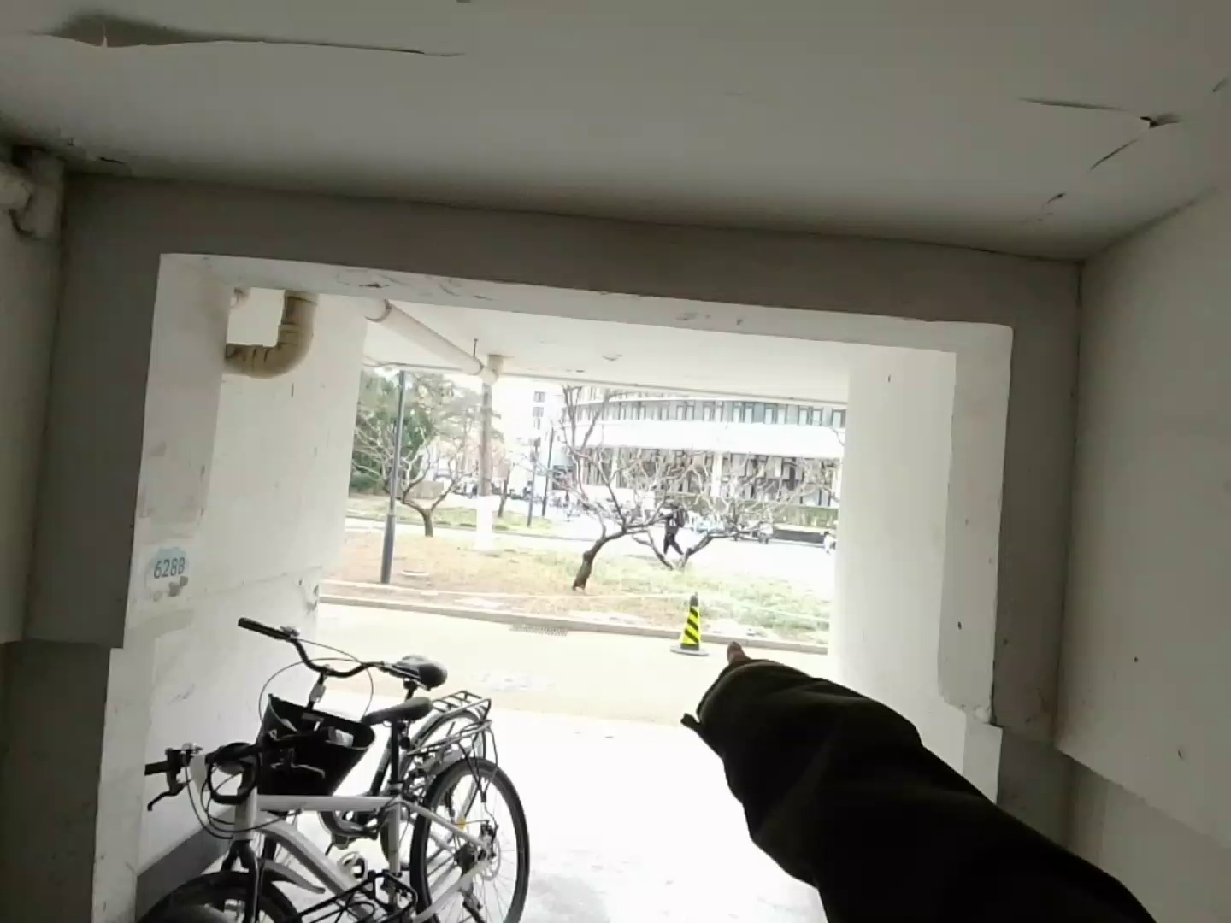
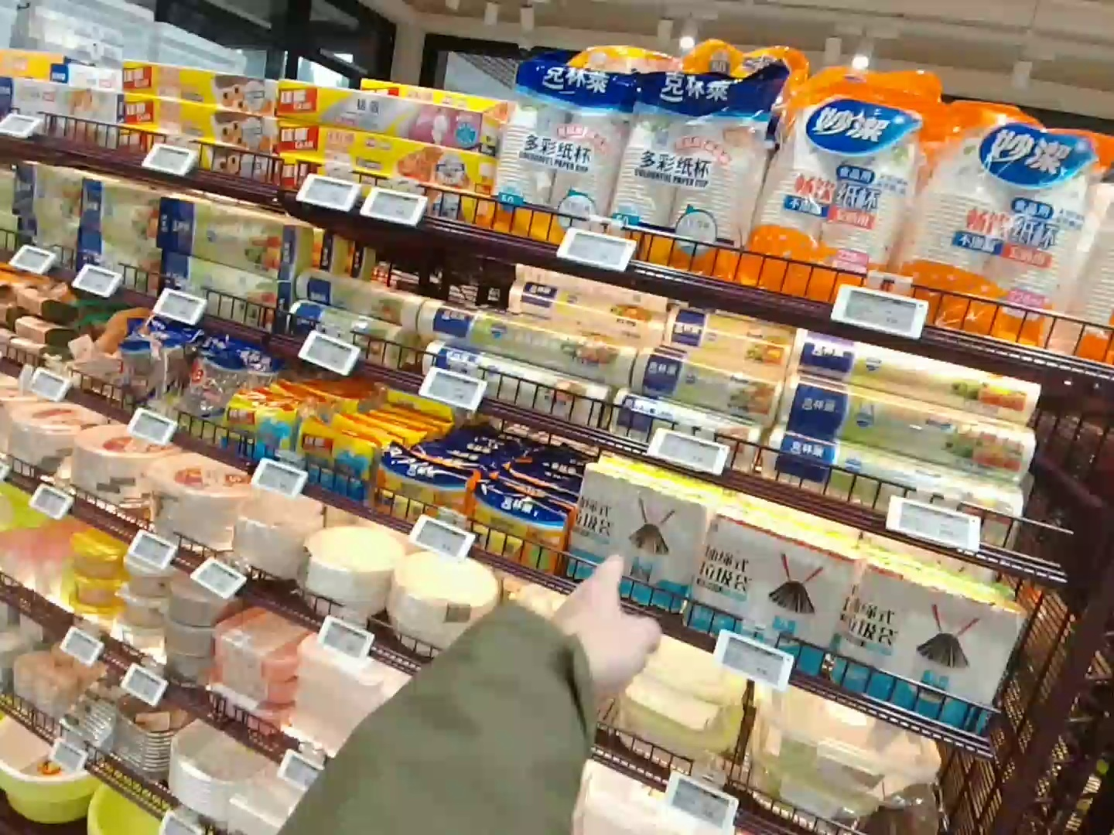
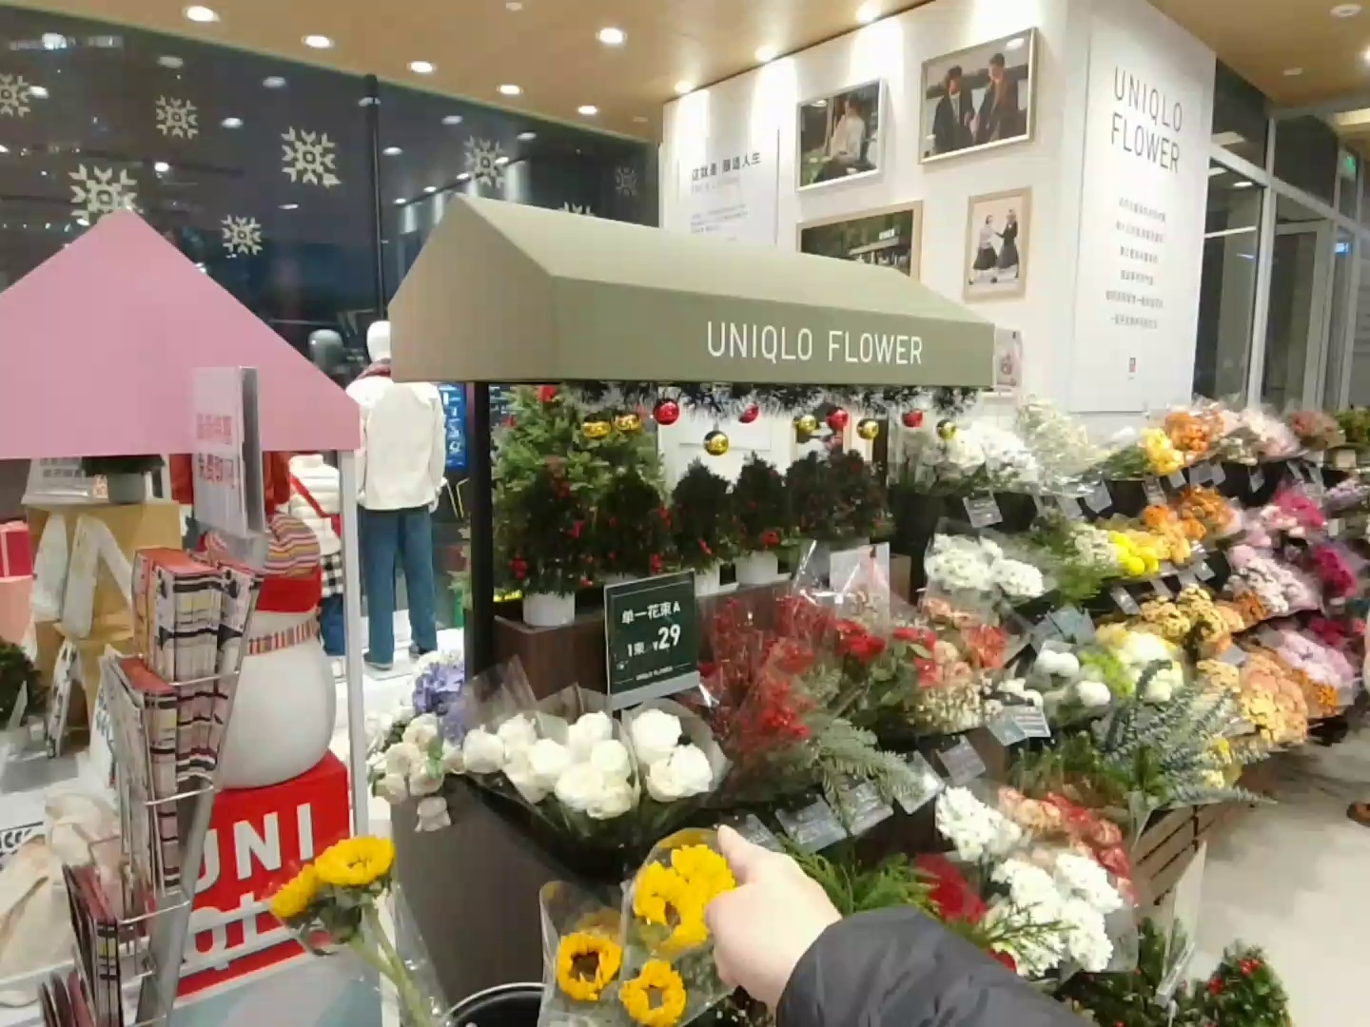
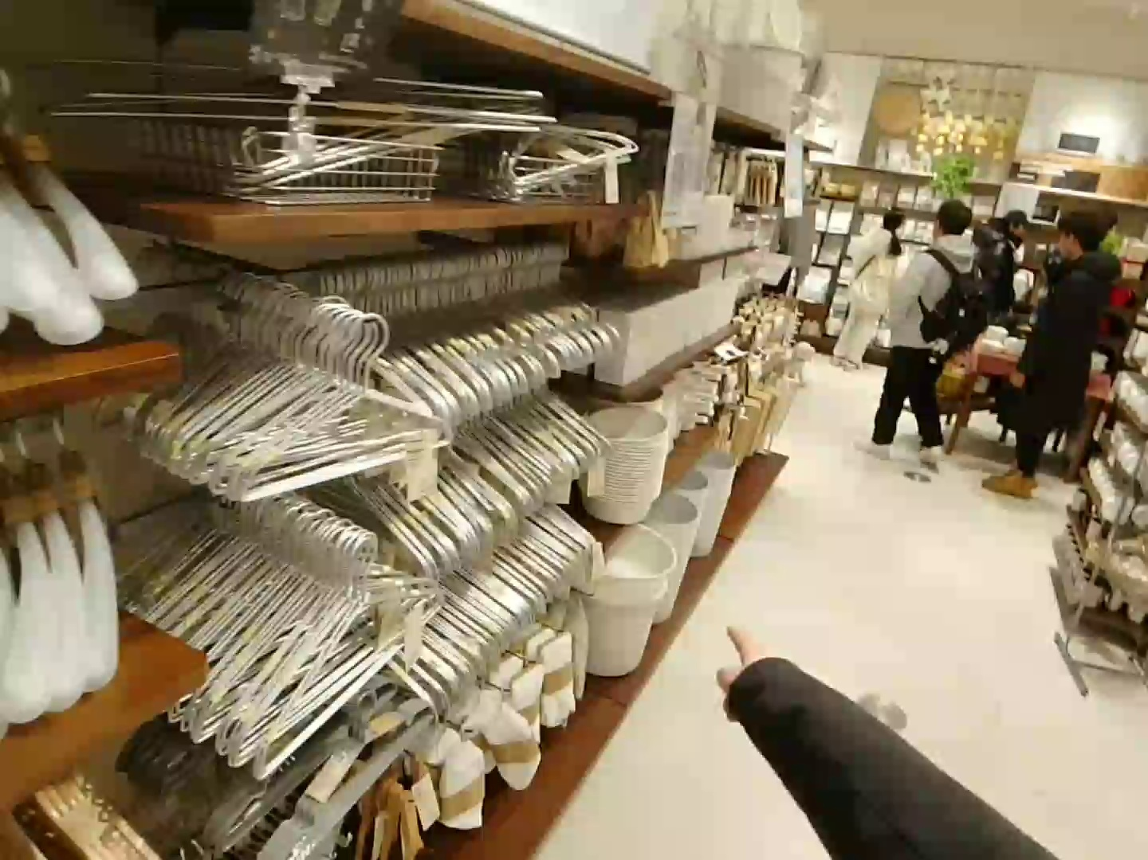
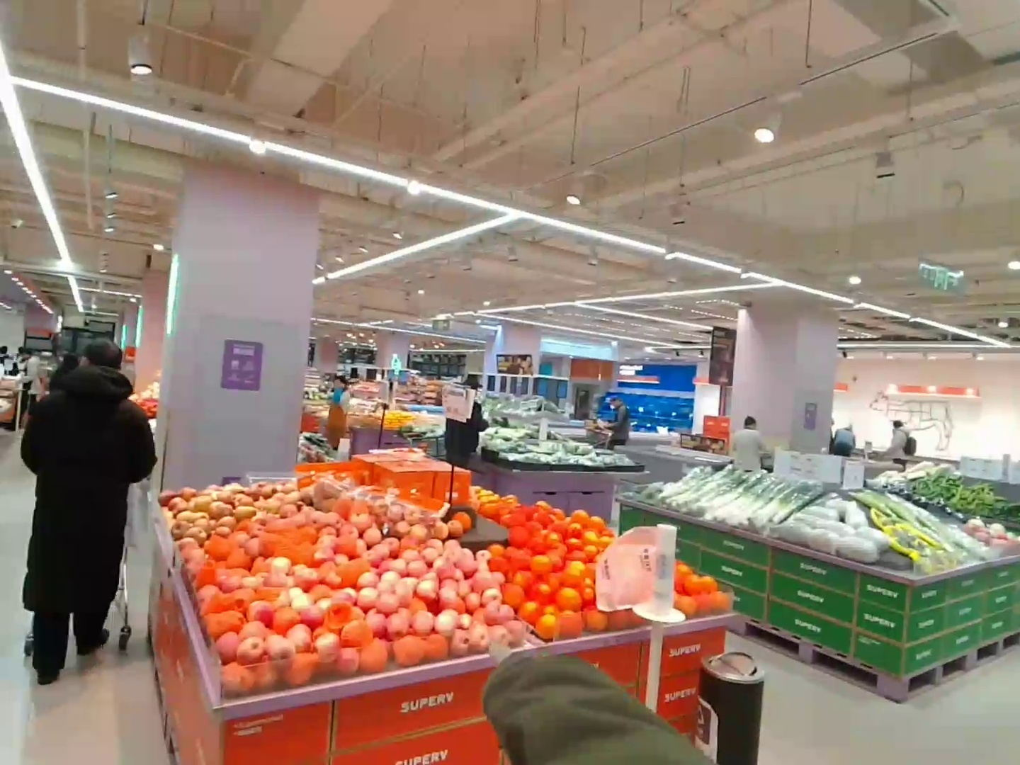
Gemini-3-Pro
662
464
1046
Qwen3-VL-8B
226
1243
1580

Slide 6
Gemini-3-Pro
Q: Is this a brown cabinet?
A: True
GT: False (TV)
Q: Is this object a bicycle?
A: True
GT: False (Traffic Cone)
Q: Does the packaging of the object right here feature an image of a broom?
A: True
GT: False (Garbage bag)
1
2
3
Qwen3-VL-8B
Q: What kind of flowers are these?...
A: Yellow Sunflowers
GT: White Carnations
Q: What is the primary function of the item I am pointing at?
A: To hang clothes
GT: To hold trash or store items
Q: What type of produce is being pointed at here?
A: Oranges
GT: Apples
1
2
3

Slide 7
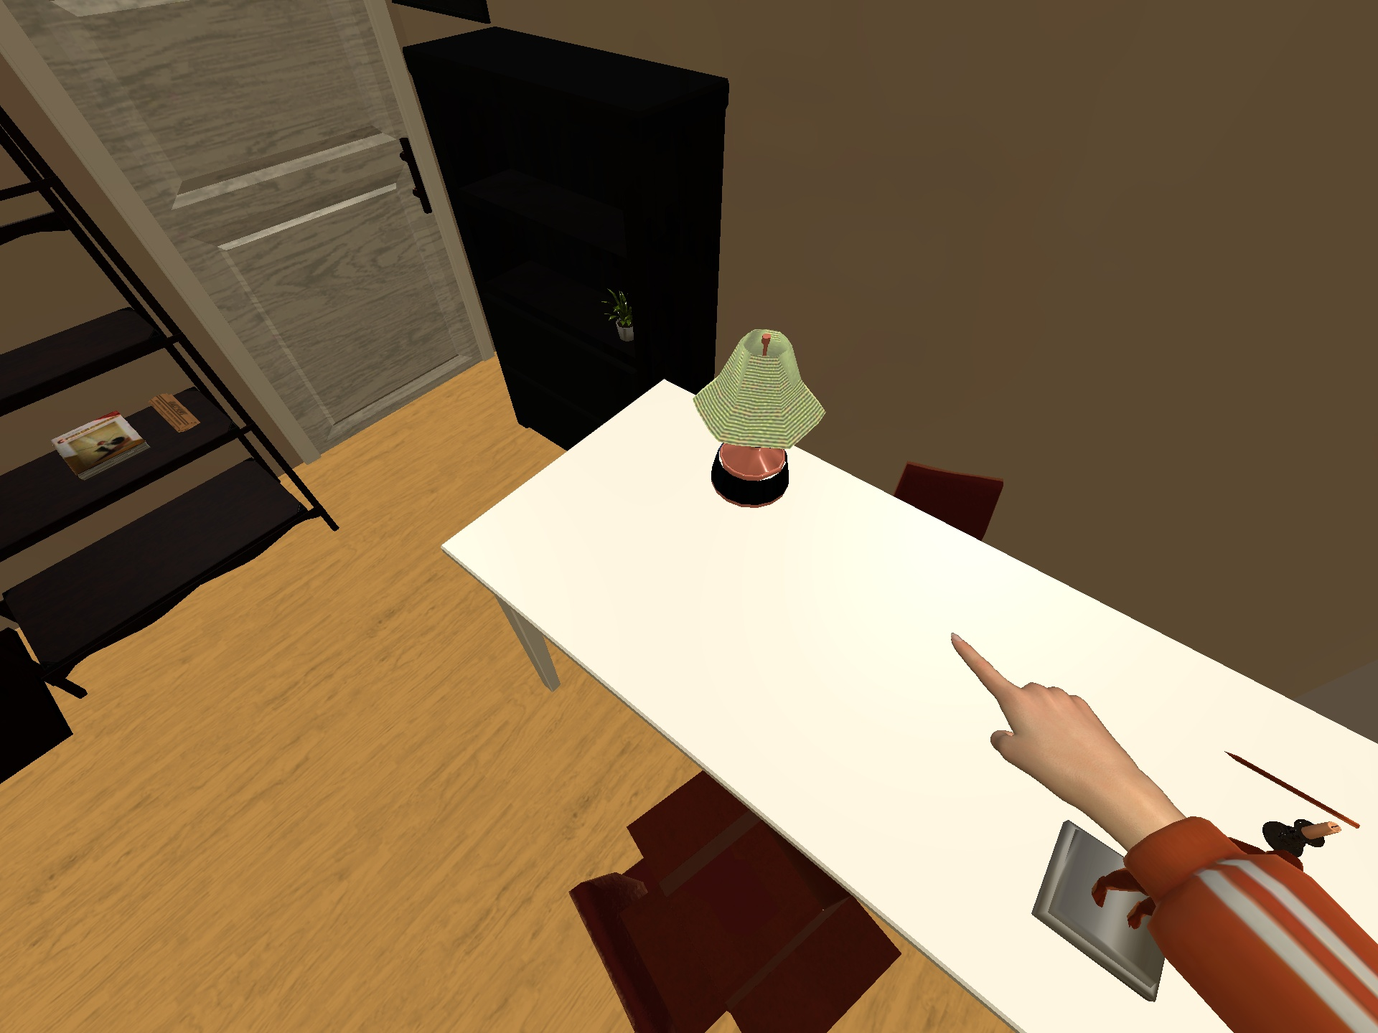
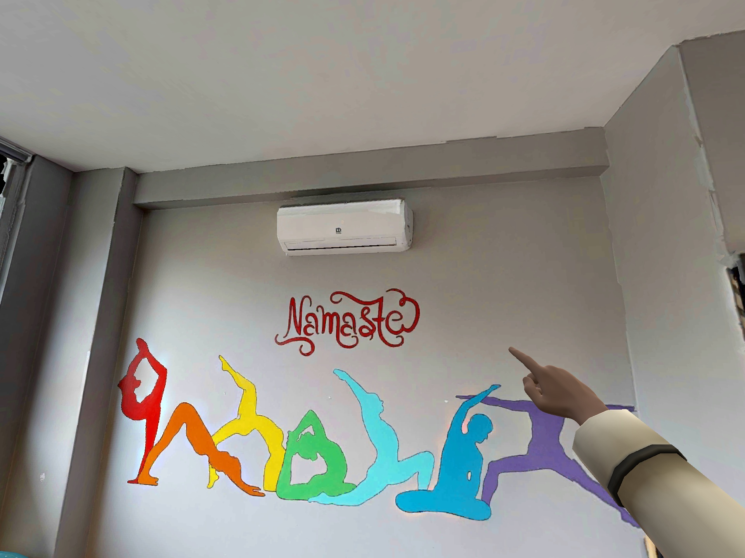
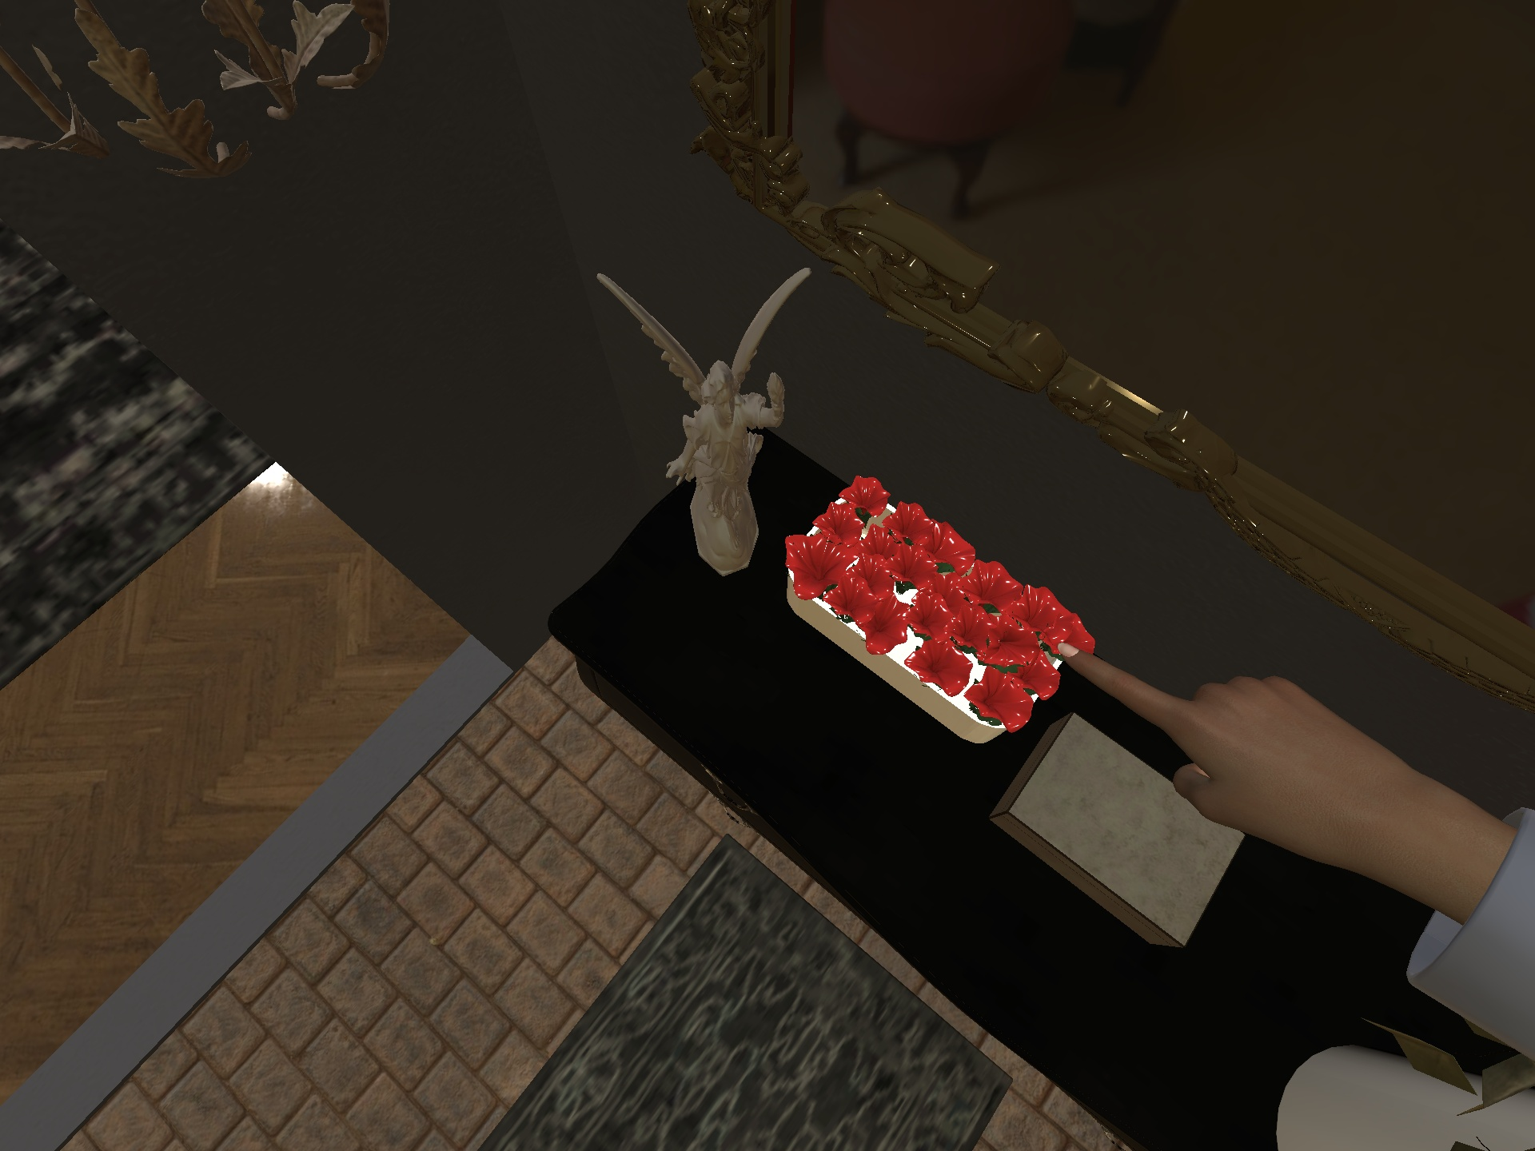
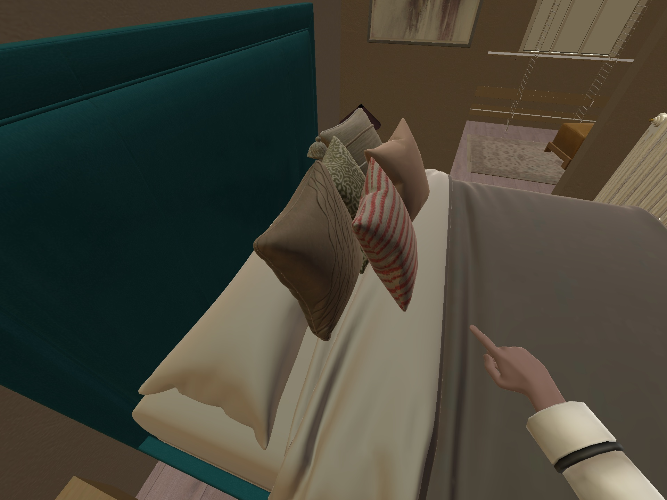
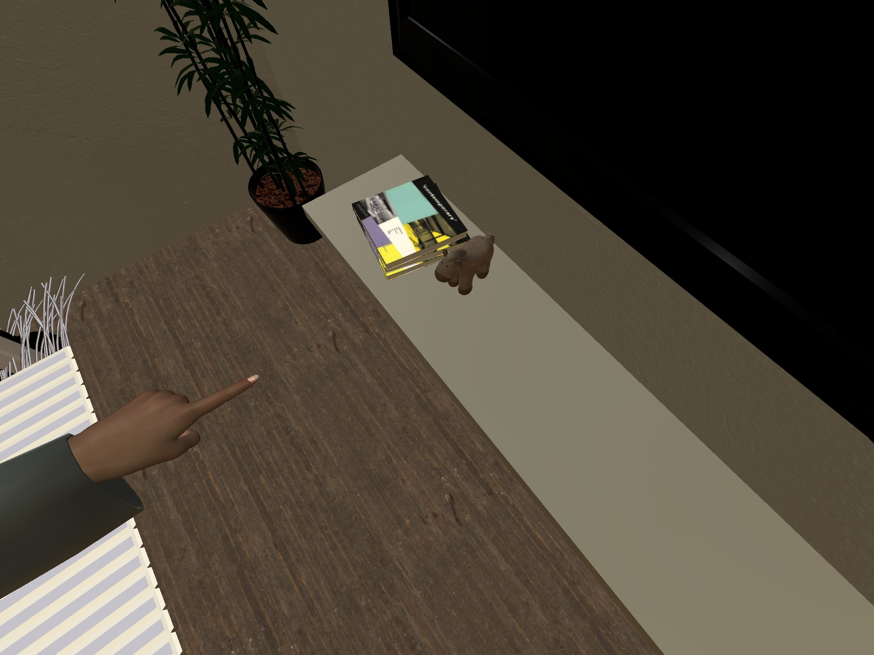
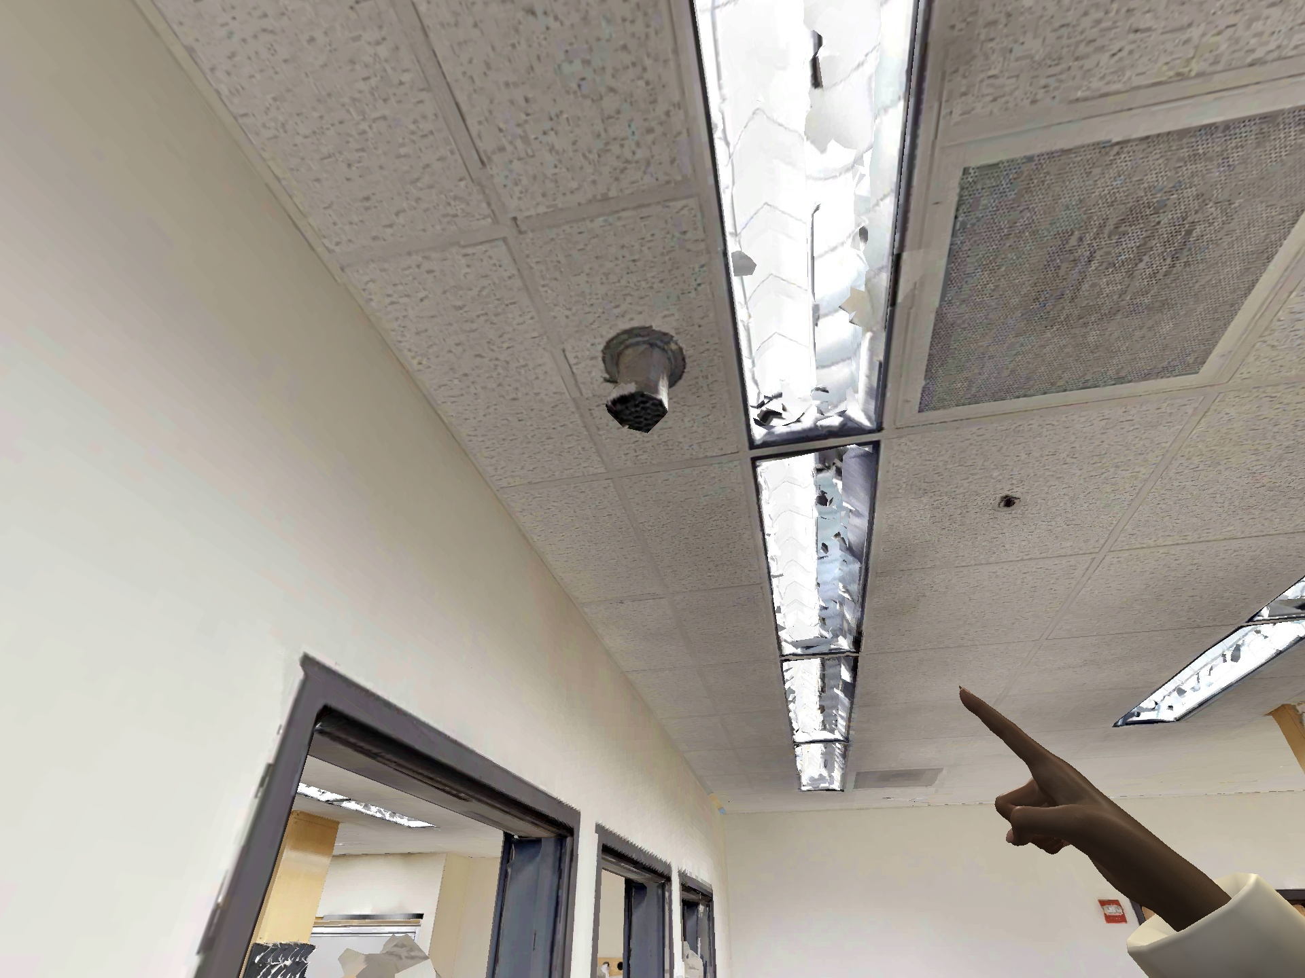
Gemini-3-Pro
Q: What is the primary function of this?...
A: Supporting a laptop
GT: Providing illumination
Q: Does this object display any visible words?
A: True
GT: False (airconditioner)
Q: Is this a living organism?
A: True
GT: False (Sculptural decoration)
1
2
3
Qwen3-VL-8B
Q: What type of object am I pointing at?...
A: Duvet
GT: Pillow
Q: What kind of item is this?
A: book
GT: plush toy
Q: What is the primary function of the object I am pointing at?...
A: To illuminate the room below
GT: To circulate or distribute airflow
1
2
3

Slide 8
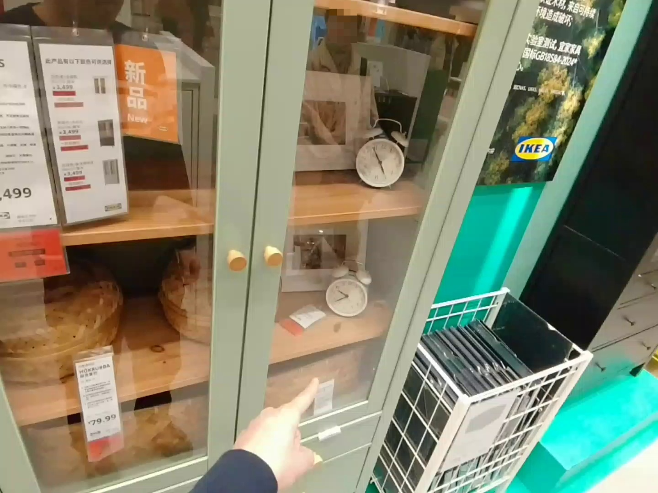
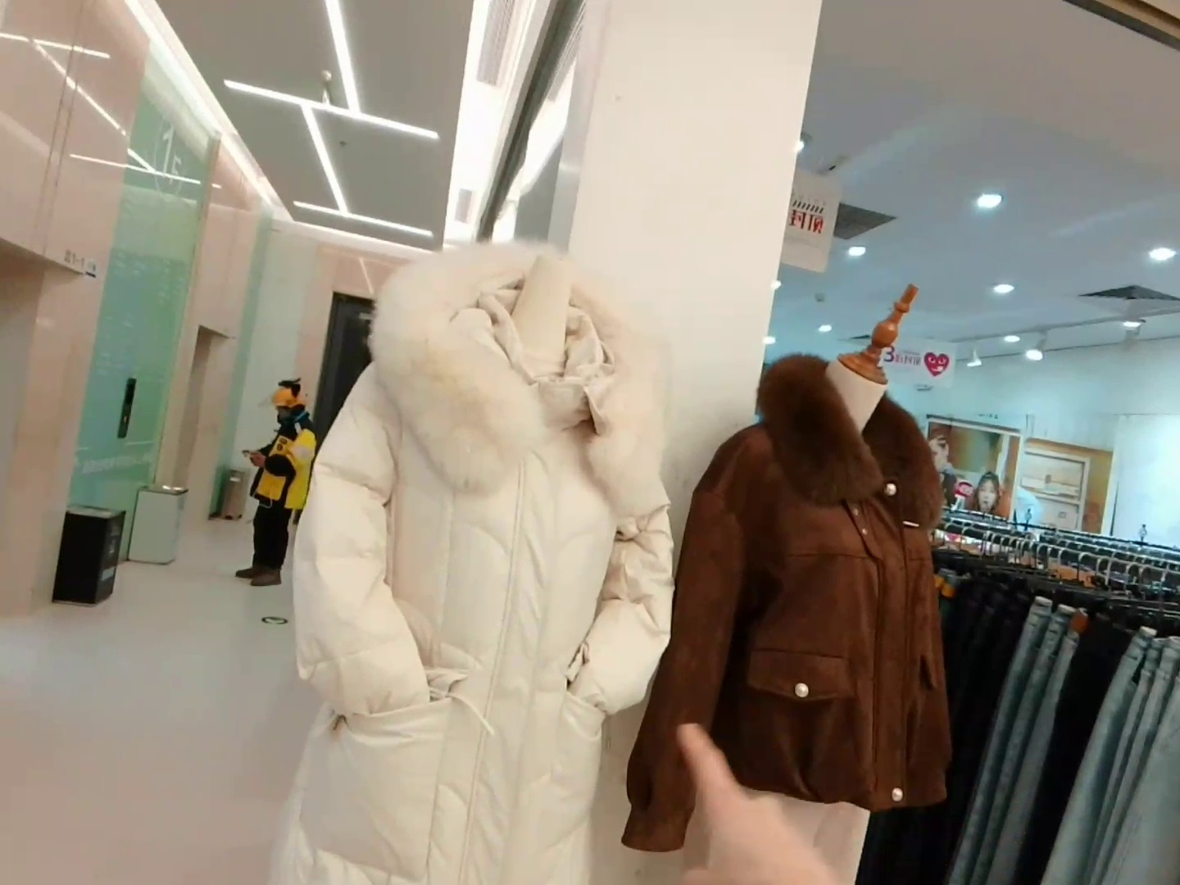
User is pointing at a clock
Q: What is this? A. clock. B. Price tag. C. Photo. D. Basket.
A. clock. (ground truth)
D. Basket.
B. Pricetag.
A. Clock.
(Fine-tuned)
User is pointing at a white jacket
Q: what is the color of the object I am pointing at?
White. (ground truth)
[...], it appears to be a brown jacket.
[...], you are pointing at is brown.
White.
(Fine-tuned)

Slide 9
Deixis Level
Implicit Pronoun
L3
“this/that”, “it”, “this one”
Towards Abstraction
Visual
Locative
L2
“this object right here/over there”
Explicit
Action
L1
“the object I am pointing at”

